Slide 1
Production of B_{c} mesons in quark fragmentation
Franciszek Pauwels Level IV Project seminar
Supervisor: prof. Peter Richardson

Slide 2
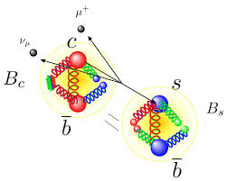
B_{c}⁺ meson: What is it?
Notes:
It is the lowest-mass bound state of the quarkonium which contains the charm quark and the bottom anti-quark
Mass first predicted in 1991 by Kwong and Rosner, at around 6.2 GeV[1]. Further excited states’ masses were predicted by Eichten and Quigg in 1994, with the mass of the 2S state at around 6.3GeV [2]
First observed by CDF collaboration at the TeVatron in the US in 1998[1]
It is of great interest to theorists, as its splitting function can be computed perturbatively.
Since then, many more excited states of this meson have been discovered, and their properties measured.

Slide 3
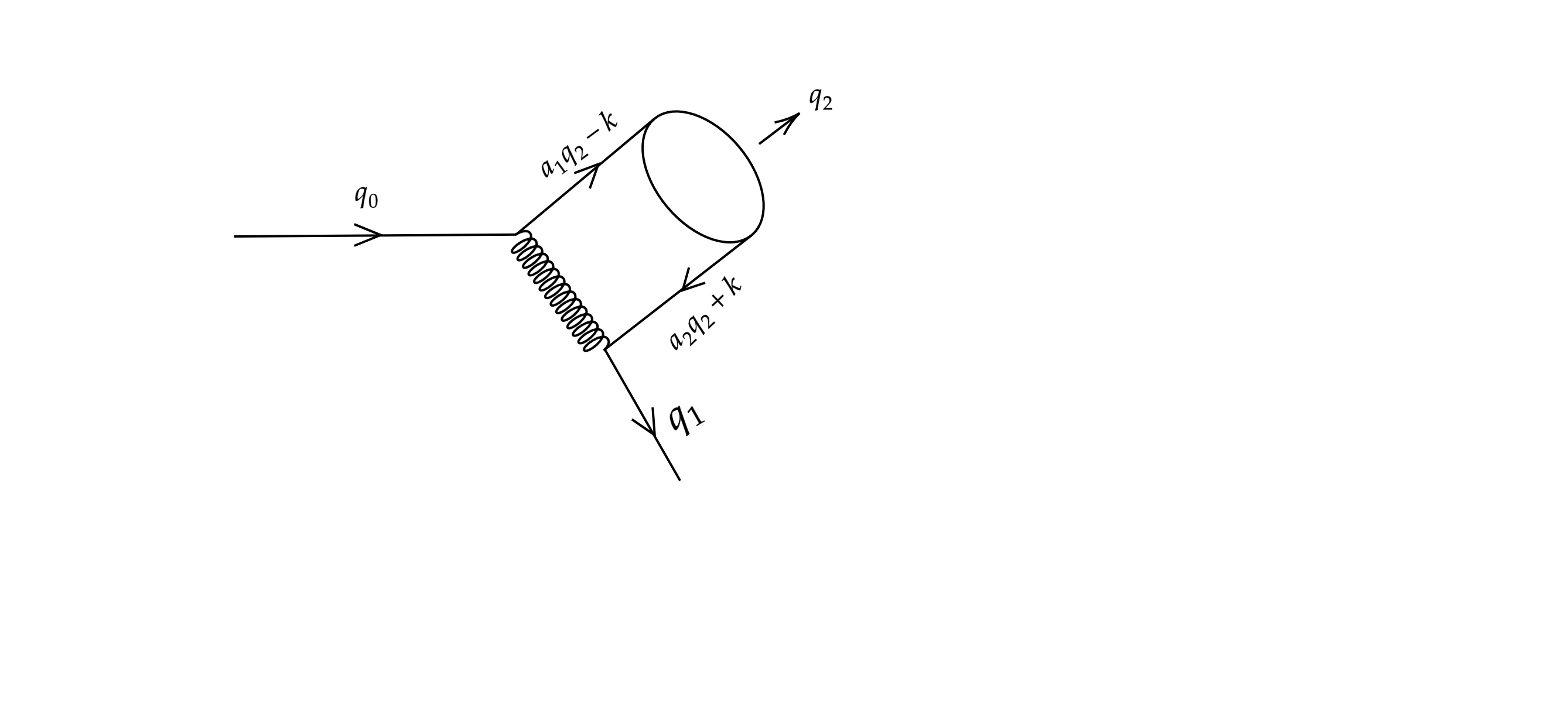
Feynman diagram describing the splitting
Notes:
The main goal of a fragmentation function is to provide the differential cross section of n+1 particles in terms of n particles. This can be done by analysis of Feynman diagrams such as this. Here, we take q0 to be the momentum of the incoming quark, q1 to be the momentum of the outgoing quark and q2 to be the momentum of the quarkonium. A1 and a2 are the relative masses of each constituent quark relative to the mass of the quarkonium (ie. A1 = m1/M etc). K here is the relative momentum of the quarks.

Slide 4
Feynman rules: How to convert Feynman diagrams to meaningful mathematical expressions
Notes:
First of all: what is the goal of a Feynman diagram? To put it simply, it is to convey some scattering process. The physical meaning of the Feynman diagram should tell us something about the scattering process, the amplitude. The Feynman rules are as follows:
Working backwards from an outgoing fermion (tracing your finger works best): Assign a u(p) to each incoming fermion, u-bar to each outgoing Fermion, v(p) to each outgoing anti-Fermion and a v-bar to each incoming anti Fermion
Assign a i*gs*gamma to each junction in the diagram.
Assign a propagator value to each internal propagator, whether it be a fermion or a gauge boson, or in our case, a gluon.
Once you trace you have covered all possible lines, you are done. The resulting number is the amplitude.

Slide 5
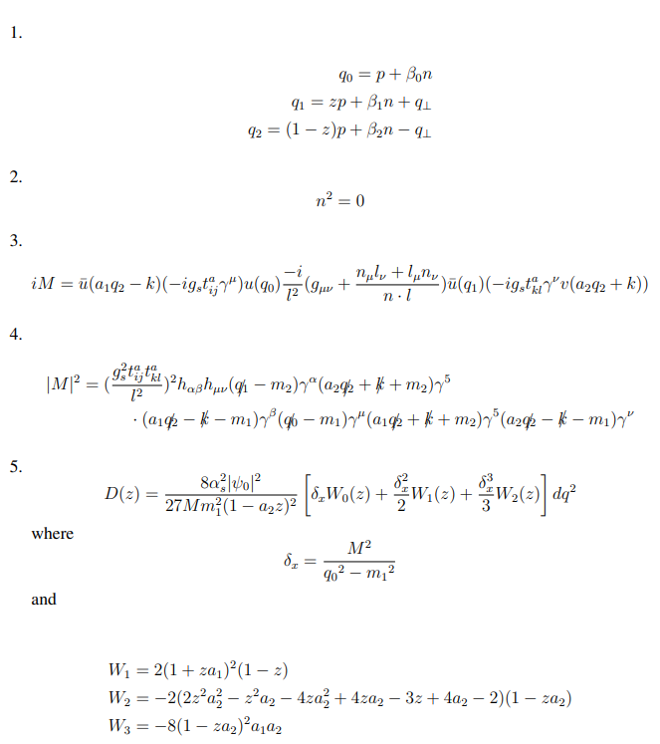
Deriving the splitting function from the Feynman diagram
Notes:
In deriving the splitting function, there are several assumptions we must make: first – the quasi collinear limit, as shown in point 1 on the slide. Next, point 2, the gauge. We will be using the light-cone gauge. Next point 3 – using Feynman rules, we can produce the following equation for the matrix element. (quick note – this is valid for the S=0 state. For the excited state, the gamma(5) matrix would become an epsilon). Taking the square of this matrix element yields the next point, 4. Quick note here –I defined this h_ab to be the propagator, to save space. Taking the trace of this (applying Gell-Mann matrix identities, and replacing g with the running coupling strength alpha s we get a rather nasty looking equation. By taking a power series expansion, in order q0 we obtain equation5. This agrees with the calculations done in 1993 by Chen[4].

Slide 6
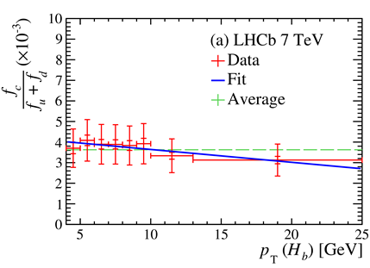
Recent results from the LHCb collaboration: data which can be compared to the simulation
Notes:
In 2019, the LHCb collaboration published a paper which detailed recent findings about the B_{c} meson
The paper included data on the ratio of production cross sections between the B_{c}⁻ meson and the B⁰ and the B⁺ mesons.
This was a good test of the accuracy of the splitting function obtained from the Feynman diagrams.
Next slide, the results from the paper by the LHCb[5] collaboration are shown in black, while the results obtained via simulations are in orange

Slide 7
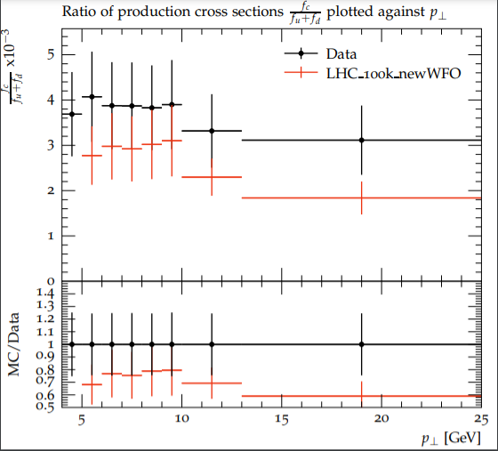
Generating results using Herwig 7 and Rivet
Notes:
Now that I had some data to compare my results to, I used the results from my splitting function calculations to generate data with Herwig and Rivet.
I used splitting of the S=0 pseudoscalar as well as the s=1 scalar meson, as the scalar meson decays to form the pseudoscalar. Herwig generated a yoda file, according to the Rivet analysis file I coded in. This file was then converted into a pdf which is what you see in front of you. Following this, a

Slide 8
Concluding remarks and questions
Notes:
Rivet and Herwig provide a very good tool to simulate particle events, and the results given by them mirror the real world quite closely. Going forward, I will be looking at the effects of higher-energy particles (P-wave mesons) on the results I obtained, as well as to use more data to test the results from the simulations., such as the pseudorapidity

Slide 9
Bibliography
[1] W. Kwong and J. L. Rosner, Phys. Rev. D 44, 212 (1991), URL https://link.aps.org/ doi/10.1103/PhysRevD.44.212.
[2] E. J. Eichten and C. Quigg, Phys. Rev. D 49, 5845 (1994), URL https://link.aps.org/ doi/10.1103/PhysRevD.49.5845.
[3] P. P. Singh, ArXiv (1998), URL https://arxiv.org/pdf/hep-ex/9807022v2.pdf
[4] Y.-Q. Chen, Phys. Rev. D 48, 5181 (1993).
[5] R. Aaij et al. (LHCb), Phys. Rev. D 100, 112006 (2019), 1910.13404.
[6]A. Buckley et al, 10.1016/j.physrep.2011.03.005

